Slide 1
Data Structure

Slide 2
Array

Slide 3
Array
Value 1 | Value 2 | Value 3 | Value 4
The simplest composite type. Items can be looked up easily by calculating the memory address from the index.
Eg. myList is located at memory address 100, then myList[10] is at memory address 100 + 8 * 10 = 180.
Note: The values are usually pointers in modern languages.

Slide 4
Linked List

Slide 5
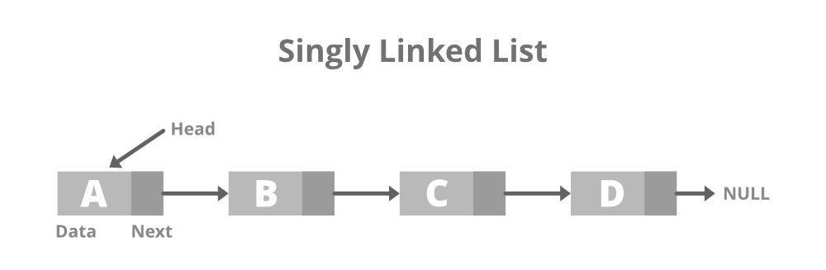
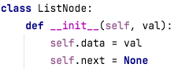
Linked list
A linked list is formed by nodes.
Each node is simply an object with data and a pointer to the next node.
Variations include doubly linked list, circular linked list.

Slide 6
Linked list vs classic array
Operations | Linked list | Classic array
Insert/Remove items | Simply adjust the “next” pointer. | Need to move every item after the insertion/deletion index.
Access an item | Need to iterate from the head. | No iteration is needed.
Memory usage | More memory is used to store the objects and the “next” pointers. | Minimal memory usage.

Slide 7
Queue and Stack

Slide 8
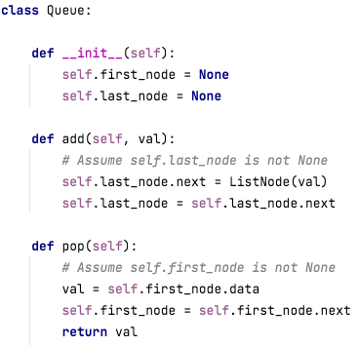
Queue
A list that supports “First in first out”.

Slide 9
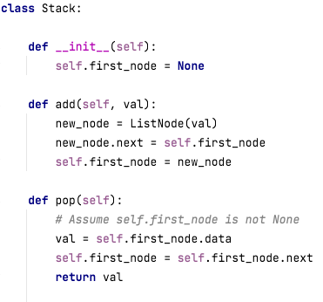
Stack
A list that supports “First in last out”.

Slide 10
Hash table

Slide 11
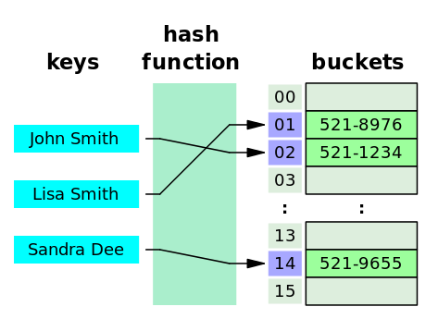
Hash table
Underlying a hash table, there is a list to store values.
Imagine it is a list of “Buckets”.
Hash function create a number for a given key. Such number is the index of the value location.

Slide 12
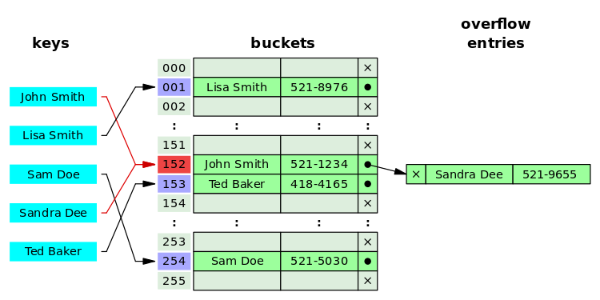
Hash collision
It is very common to have hash collision where two different keys are mapped to the same index.
[Separate chaining]
If collision happens, records are chained up in a linked list.

Slide 13
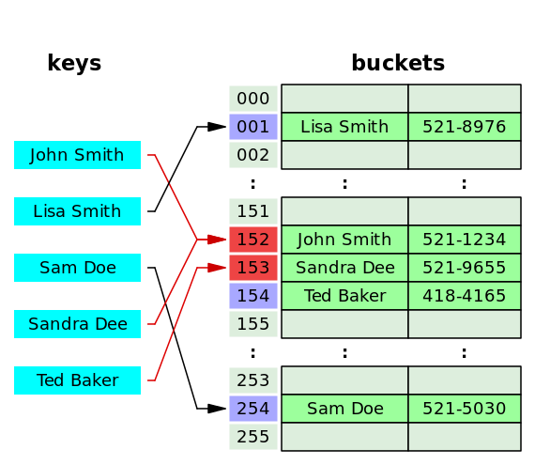
Hash collision
[Open addressing]
If collision happens, the algorithm search down the list for an empty slot

Slide 14
Python dictionary implementation
https://github.com/python/cpython/blob/main/Objects/dictobject.c

Slide 15
Tree

Slide 16
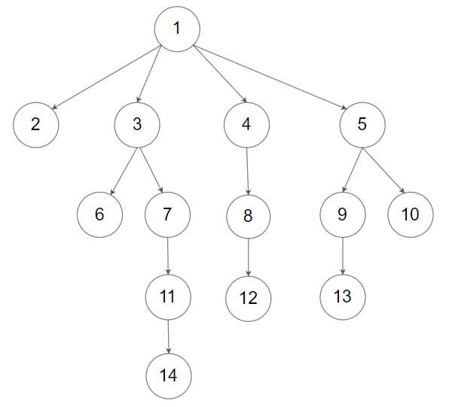
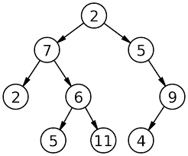
Trees
Binary Tree
N-ary Tree

